Slide 1

Pathway analysis
Biostat & Bioinfo short course series
02/03/2020
Jianying Li

Slide 2
Pathway analysis resources from the NIEHS Library
Need more resources? Visit the NIEHS Library or email library@niehs.nih.gov!
Print
Decoding the Language of Genetics (2015)
A Bioinformatics Guide for Molecular Biologists (2014)
eBooks
Computational Methods for Single-Cell Data Analysis (2019)
High-Throughput Metabolomics Methods and Protocols (2019)
Synthetic Metabolic Pathways Methods and Protocols (2018)
Biological Networks and Pathway Analysis (2017)
Computational Methods for Processing and Analysis of Biological Pathways (2017)
Computational Systems Toxicology (2015)

Slide 3
An outline of the pathway analysis course
Background of pathway analysis
Random variable distribution and its usage in the pathway analysis
A parametric approach
Hypergeometric distribution in details
An example: IPA
Non-parametric approach
Experimental layout
An example: GSEA
Pathway analysis summary
Making a right choice
Pros and cons
Hands on practice
R and basic distribution
GSEA

Slide 4

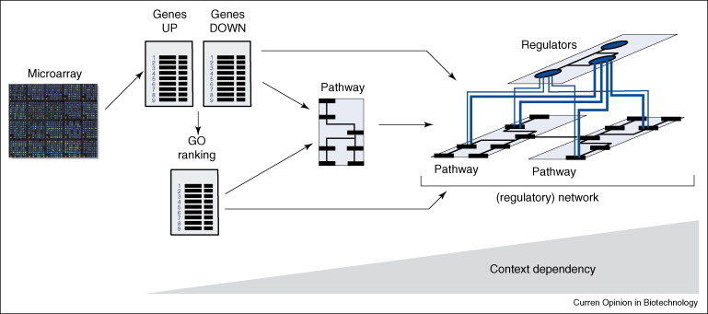
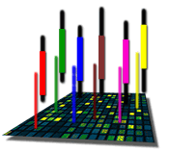
The Road to Pathway Analysis
Next Gen RNA-Seq
Adapted from Werner (2008), Current Opinion in Biotech., 19:50-64
Notes:
Give credit to Pierre and others
4

Slide 5
Why pathway analysis?
Biological responses are systematic and collaborative
Modern technologies provide high-throughput measurement
Rich knowledge-based accumulation available
Statistical frame works provide the analytical component

Slide 6
Common experimental rationale
An established measurement of gene expression profile:
Microarray
RNAseq
Nano-string
Etc.
Samples obtained from two conditions (e.g. treated vs. control)
Several biological replicates at each condition
Our focus is “how would a study object respond differently at two conditions?)
Gene-centered analysis often
Asses statistical difference between conditions via some testing, t-test, limma etc.
Correct for multiple testing issues
Obtain a set of differentially expressed genes (DEGs)
Where is the biology??

Slide 7
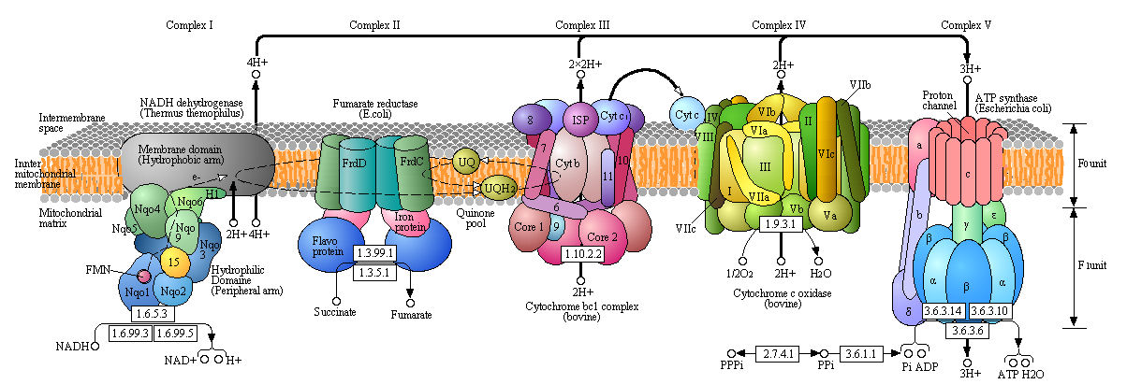
The oxidative phosphorylation
A set of molecules in a cell that work together through a series of actions to achieve a particular outcome
http://employees.csbsju.edu/hjakubowski/classes/ch331/oxphos/olcouplingoxphos.html

Slide 8
Rich knowledge-based accumulation available
GeneOntology (originated since 1998)
Molecular function describing activities, such as catalytic or binding activities, at the molecular level
Biological process referring to a biological objective to which the gene product contributes
Cellular component referring to the place in the cell (i.e. the location) where a gene product is found
KEGG pathway (originated since 1996)
Metabolism: carbohydrates, energy, lipid, nucleotides, amino acid, xenobiotics
Human diseases
Genetic information processing
Transfac/Transpath
Data on transcription factors, their experimentally-proven binding sites, and regulated genes
Protein-protein interactions and directed modification of proteins involved in signal transduction pathways,
It is a knowledge based/driven approach
Pathway --- gene sets are interexchange

Slide 9
Gene sets – generalized definition
Gene sets are sets of genes that have something in common, e. g., that they are
part of the same pathway
coding for proteins that are part of the same cellular component
co-expressed under certain conditions
putative targets of the same regulatory factor
on the same cytogenetic band
have come up as hits in some published assay
Etc.

Slide 10
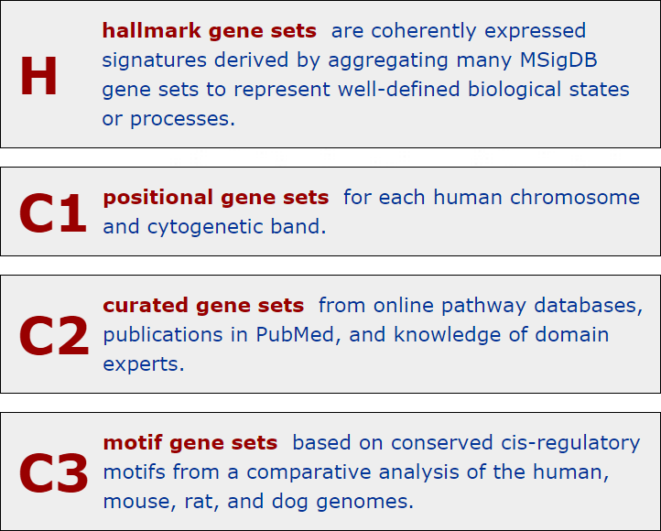
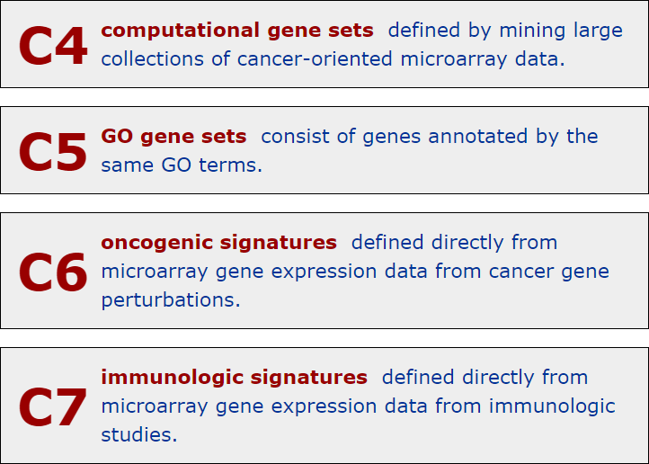
Molecular Signatures Database (MSigDB v5.2)
Free database (http://www.broadinstitute.org/gsea/msigdb)

Slide 11
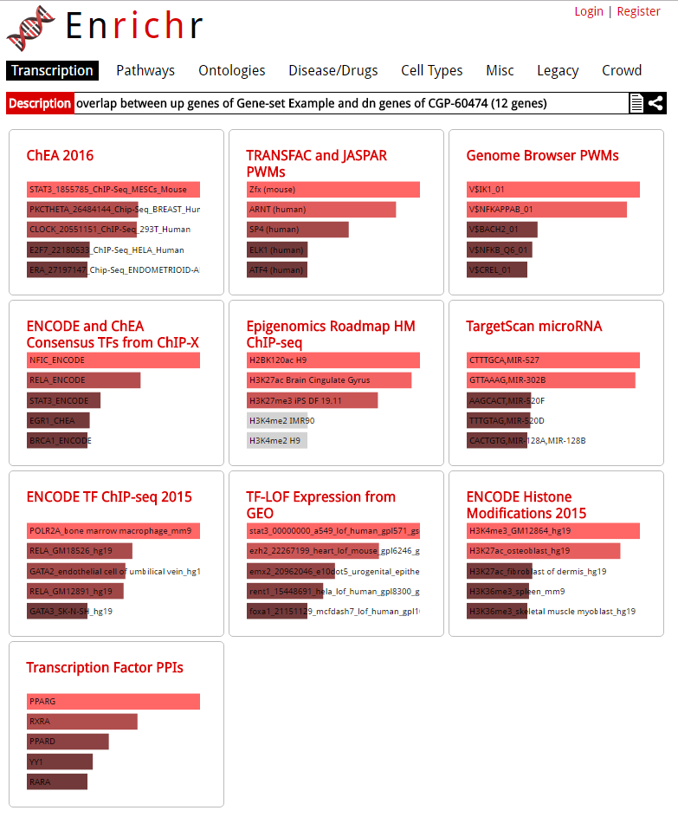
http://amp.pharm.mssm.edu/Enrichr/enrich
Notes:
Enrichr!!

Slide 12
The statistical framework
Well-established statistical and computation algorithms
Parametric method
Hypergeometric test
Fisher’s exact test
Non-parametric approaches
GSEA
GSA
Etc.
Another categorization
Non-topology-based (non-TB):
ORA (over representation analysis), i.e. Fisher test, chi-square test
FCS (functional class sorting methods), GSEA, GSA, etc. Draws sub-networks around the selected objects
Topology-based (TB)Shortest paths: TopoGSA, ROntoTools etc.

Slide 13
A good place to start
A simple example:
5 patients with the disease D and 5 healthy control subjects
Checked for elevated levels of the blood constituent C.
4 of the patients, but only 2 of the healthy subjects show an elevated level of C.
May we infer that the concentration of C is elevated in patients with disease D more often than in healthy subjects?
Or could our result have been mere coincidence?

Slide 14
2x2 contingency table
 | Patient with disease D | Healthy control subject | Total
Elevated level of compound C | 4 | 2 | 6
Normal level of compound C | 1 | 3 | 4
Total | 5 | 5 | 10
 | Patient with disease D | Healthy control subject | Total
Elevated level of compound C | 4 (3) | 2 (3) | 6
Normal level of compound C | 1 (2) | 3 (2) | 4
Total | 5 | 5 | 10

Slide 15
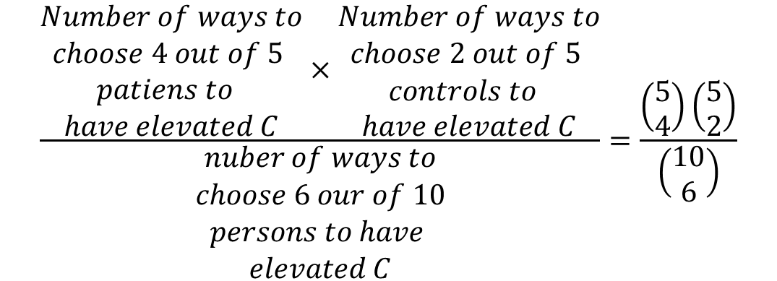
Hypergeometric distribution
Probability to get this 2×2 table without an association
between D and C:
$$\frac{\begin{aligned}Number of ways to \\ choose 4 out of 5 \\ patiens to \\ have elevated C\end{aligned}×\begin{aligned}Number of ways to \\ choose 2 out of 5 \\ controls to \\ have elevated C\end{aligned}}{\begin{aligned}nuber of ways to \\ choose 6 our of 10 \\ persons to have \\ elevated C\end{aligned}}=\frac{\left(\begin{aligned}5 \\ 4\end{aligned}\right)\left(\begin{aligned}5 \\ 2\end{aligned}\right)}{\left(\begin{aligned}10 \\ 6\end{aligned}\right)}$$
in R:
> dhyper( 4, 5, 5, 6 )
[1] 0.2380952

Slide 16
Hypergeometric distribution
Under the null hypothesis, i.e., the assumption that there is
no association between elevated levels of compound C and
presence of disease D, the probability that all 5 patients have
elevated levels of C would be,
 | Patient with disease D | Healthy control subject | Total
Elevated level of compound C | 5 | 1 | 6
Normal level of compound C | 0 | 4 | 4
Total | 5 | 5 | 10
in R:
> dhyper( 5, 5, 5, 6 )
[1] 0.02380952
Notes:
What is the probability to all five patients had elevated C?

Slide 17
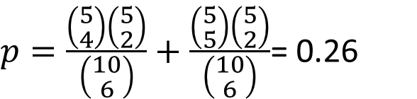
Hypergeometric distribution
Under the null hypothesis, i.e., the assumption that there is
no association between elevated levels of compound C and
presence of disease D, the probability that 4 or even more of
the patients have elevated levels of C,
$p=\frac{\left(\begin{aligned}5 \\ 4\end{aligned}\right)\left(\begin{aligned}5 \\ 2\end{aligned}\right)}{\left(\begin{aligned}10 \\ 6\end{aligned}\right)}+\frac{\left(\begin{aligned}5 \\ 5\end{aligned}\right)\left(\begin{aligned}5 \\ 2\end{aligned}\right)}{\left(\begin{aligned}10 \\ 6\end{aligned}\right)}$= 0.26
This is insignificant
in R:
> 1 - phyper(3, 5, 5, 6 )
[1] 0.2619048

Slide 18
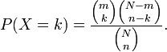
Hypergeometric Test (Right-tailed)
An urn with two types of marbles:
N total # of marbles
Of which, m # of red marbles
Drawing a red marble is a success!
Drawing a white marble is a failure!
n is the # of marbles randomly drawn
k is the # of successes (red marbles) in the sample
Hypergeometric distribution gives the probability
for k = 0,1,2,…,n
k<=m, n-k <=N-m

Slide 19
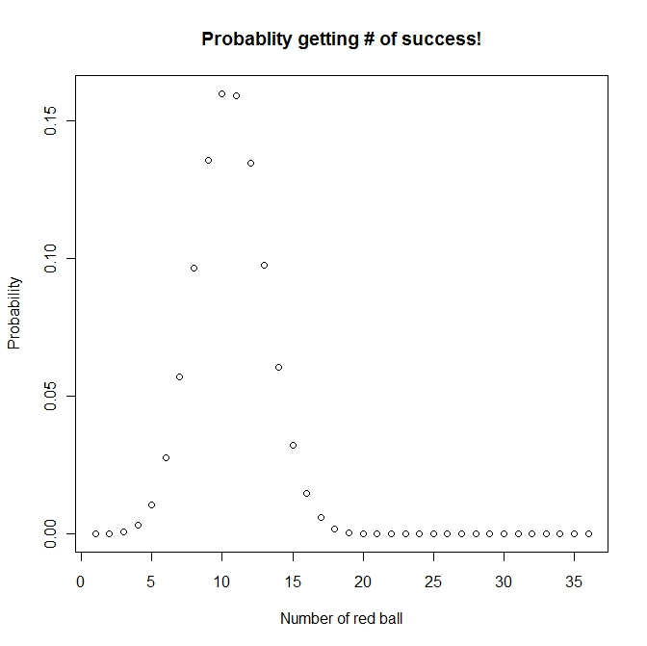
Hypergeometric distribution
m
Number of red ball: 50
Number of white ball: 120
Number of ball drawn (without replacement): 36
Possible number of success ??
(0,1, 2, ….36),
Probability to get 20 red balls is: 0.0001494571
N
n
p(k=20, 36, 50, 170)
http://www.aiaccess.net/English/Glossaries/GlosMod/e_gm_hypergeometric.htm

Slide 20
Pathway analysis (behind the scene)
Contingency table
DEG Not DEGs totals
In a GO category x m-x m
Not in GO category k-x n-k+x n
totals k m+n -k m + n (genes on array)
So, now you are probably given something like the following:
x <- 5 #num_of_DEG in GO
m <- 20 #num_of_gene on chip in GO
n <- 500 #num_of_gene on chip NOT in GO
k <- 40 #num_of_DEG
N
Hypergeometric test vs. FET, we shall get same result
phyper((x-1), m, n, k, lower.tail=FALSE)
(fisher.test(matrix(c(x,(k-x), (m-x), (n-k+x)),2,2), alternative='greater'))$p.value

Slide 21
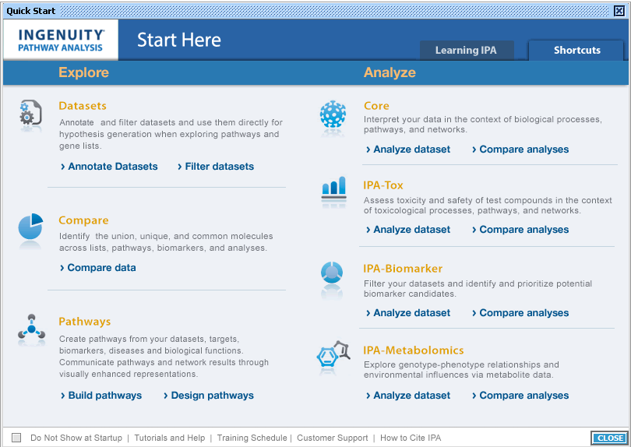

Slide 22
Ingenuity Pathway Analysis (IPA) --Knowledgebase
Desktop Java application utilizing a remote server for data, analysis and file management
IPA Ontology: Curation of the scientific literature and content extraction of the IPA repository of molecular interactions, regulatory events, biological processes, gene-to-phenotype associations, and chemical knowledge

Slide 23
IPA Enrichment Analysis
Uses the Fisher’s exact test to determine the significance of a functional group or pathway
# molecules in a list that are associated with a function/pathway (k)
total # of molecules that are associated with a function/pathway (m)
# of molecules in all possible functions/pathways (N)
# of molecules in a list (n)

Slide 24
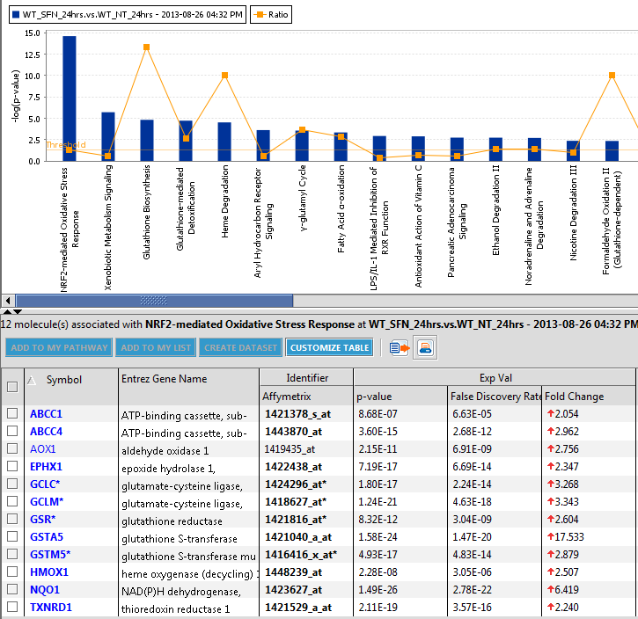
All the DEGs in the pathway are up-regulated
Nrf2-mediated oxidative stress in wild type strain at 24 hours

Slide 25
Hypergeometric Test (Right-tailed)
Used in Ingenuity Pathway Analysis (IPA)
Commercial software (http://www.ingenuity.com/products/ipa)
Pros:
Great source of clean, expertly curated gene sets
Cons:
Not free
Throws away information by only using DEG list

Slide 26
Hypergeometric Test (Right-tailed)
Used in Database for Annotation, Visualization and Integrated Discovery (DAVID)
Free software (https://david.ncifcrf.gov)
Pros:
Easy to use (web-based)
Large collection of gene sets
Free access
Cons:
Gene sets are not as clean
Throws away information by only using DEG list

Slide 27
Sampling over genes
Hypergeometric testing for gene sets has been criticized on the ground of it sampling over genes (observation) instead of over microarrays (subjects)
Hence, the meaning of the p values is quite unclear.
Especially: Correlations between genes inflate the apparent sample size, causing potentially severe over-estimation of significance.
Increasing the number of replicates influences significance only indirectly.
Goeman and Buhlmann, 2007

Slide 28
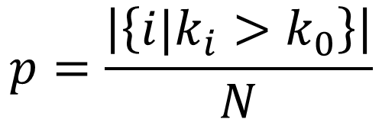
Sampling over subjects
Instead of using the hypergeometric distribution to get a p value from out statistic, we should better use subject permutation:
Let L₀ be the list of differential expressed genes and m=∣L₀∣ its size.
For N permutations σ_{i} (i=1,...,N) of the subject labels, calculate the DE statistic and let Li be the list of the m top ranking genes.
Let k_{i} be the number of differentially expressed genes in the gene set, i.e. the size of the intersection L_{i} ∩ S.
The p value for gene set S is now the fraction of permutation that had a larger gene set than the correct sample assignment, i.e.,
$$p=\frac{\left|\left\{i|k_{i}>k_{0}\right\}\right|}{N}$$
Goeman and Buhlmann, 2007

Slide 29
The universe matters
It is important to choose the universe correctly
Case 1: universe is all genes in the genome
 | DEGs | Non-DEGs | Total
In GO | 10 | 30 | 40
Not in GO | 390 | 3570 | 3960
Total | 400 | 3600 | 4000
p=0.049
Case 2: universe is only expressed genes
 | DEGs | Non-DEGs | Total
In GO | 10 | 30 | 40
Not in GO | 390 | 570 | 960
Total | 400 | 600 | 1000
p=0.0048

Slide 30
Sets are overlapped
A
B
Set B is enriched only because of it overlap with set A

Slide 31
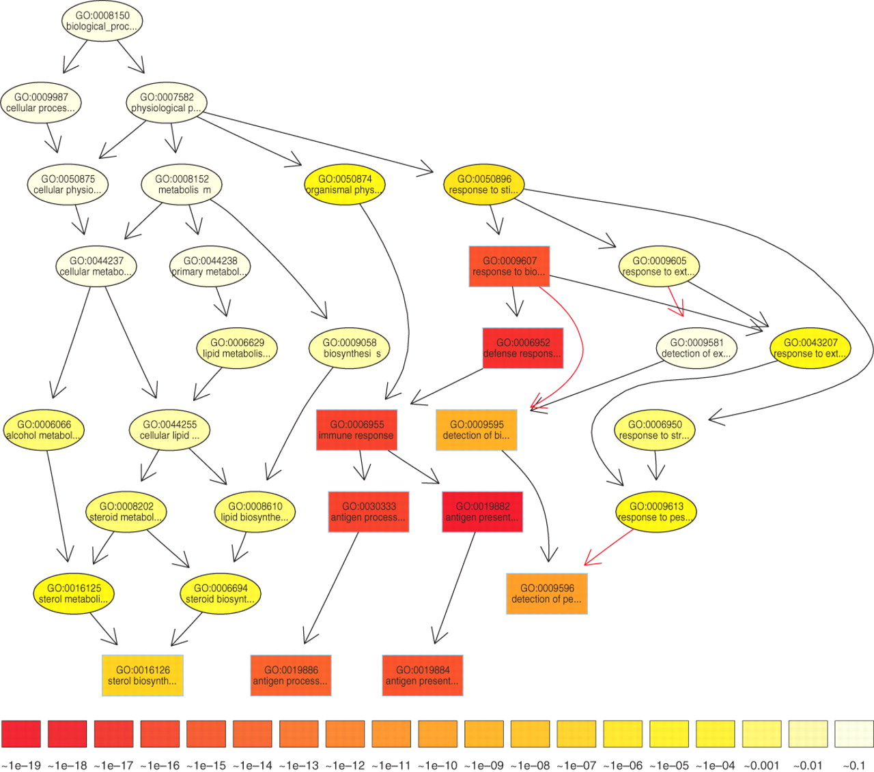

The subgraph induced by the 10 most significant GO terms identified by a current state-of-the-art method for scoring GO terms for enrichment.
TopGO’s elimination algorithm
Test the leaf sets first. If significant,
remove its “genes” before testing its
ancestor sets
TopGO’s weight algorithm
The genes are weighted by their relevance
in the significant nodes.
The enrichment score of a parent (gene
node u) is compared with the scores of
its children.
Children with a better score than u
represent the interesting genes better.
Therefore, their significance is increased
Children with a lower score than u have
their significance reduced.
Alexa A et al. Bioinformatics 2006;22:1600-1607
© The Author 2006. Published by Oxford University Press. All rights reserved. For Permissions, please email: journals.permissions@oxfordjournals.org
Notes:
The subgraph induced by the 10 most significant GO terms identified by a current state-of-the-art method for scoring GO terms for enrichment. Boxes indicate the 10 most significant terms. Box color represents significance, ranging from dark red (most significant) to light yellow (least significant). The numbers in the legend represent the magnitude of the raw p-values associated with the respective color. Black arrows indicate is–a relationships and red arrows part–of relationships.

Slide 32
A non-parametric approach
Compare a sample empirical distribution function to the reference distribution
Or, compare two sample empirical distribution functions
Required data:
Ranked list of genes sorted by differential expression (includes all genes)
A gene set
If the genes in the gene set tend to fall near either end of the ranked list, the gene set is considered significantly enriched
The test significance is obtained from empirical distribution
Permutation based
Bootstrapping
Etc.

Slide 33
A non-parametric approach (GSEA)
Mootha et al. [2003] suggest to use Kolmogorov-Smirnov (K-S) - like statistics test
The GSEA method consists three important steps:
Calculation of the enrichment score (ES) for each gene set (e.g., pathway).
Eestimation of the statistical significance of the ES
Adjustment for multiple hypothesis testing
To get the ES
Sort all genes by LFC.
Go through the list, increasing a running sum for each gene in the gene set by (N-n), and decreasing it for each gene not in the gene set by n.
[N: number of genes, n: size of gene set]
The maximum value of the running sum is the enrichment score (ES).

Slide 34
A non-parametric approach (GSEA)
To access the significance
A null distribution of the ES is created in the second step using an empirical phenotype-based permutation test
The significance of a pathway is assessed relative to this null distribution
In the last step, normalized ES (NES) of each gene set (pathway) is calculated based on the size of the set. False discovery rate corresponding to each NES is also determined
Improved enrichment score
The updated GSEA algorithm [Subramanian et al., PNAS 102 (2005) 15545] weights the in-/decrements of the running sum by the LFC.

Slide 35
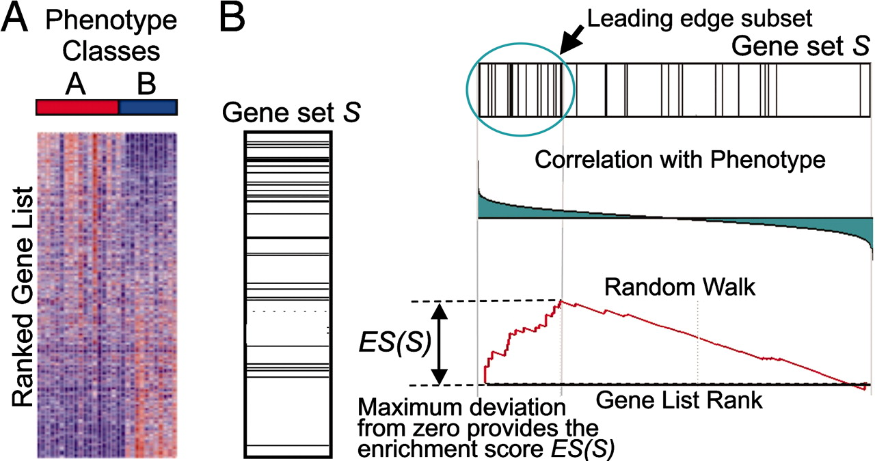
A GSEA overview illustrating the method.
Subramanian A et al. PNAS 2005;102:15545-15550
©2005 by National Academy of Sciences
Notes:
A GSEA overview illustrating the method. (A) An expression data set sorted by correlation with phenotype, the corresponding heat map, and the “gene tags,” i.e., location of genes from a set S within the sorted list. (B) Plot of the running sum for S in the data set, including the location of the maximum enrichment score (ES) and the leading-edge subset.

Slide 36
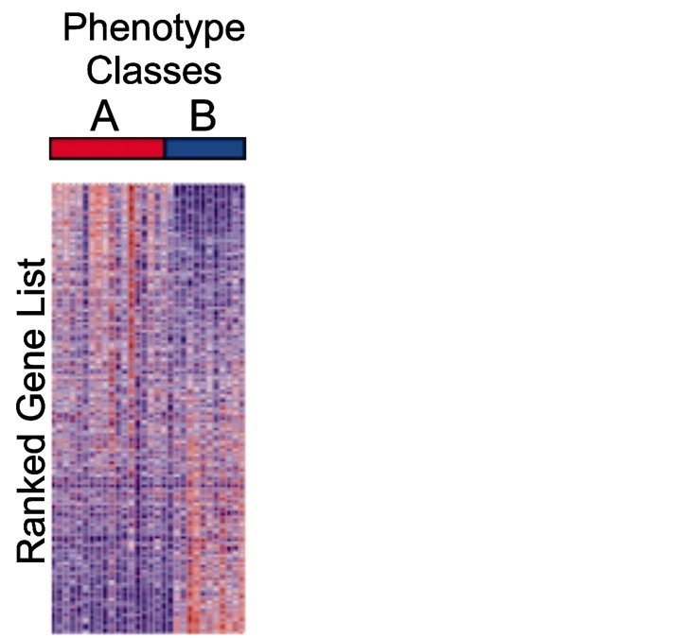
Kolmogorov–Smirnov (KS) Test
(upregulated)
(downregulated)

Slide 37
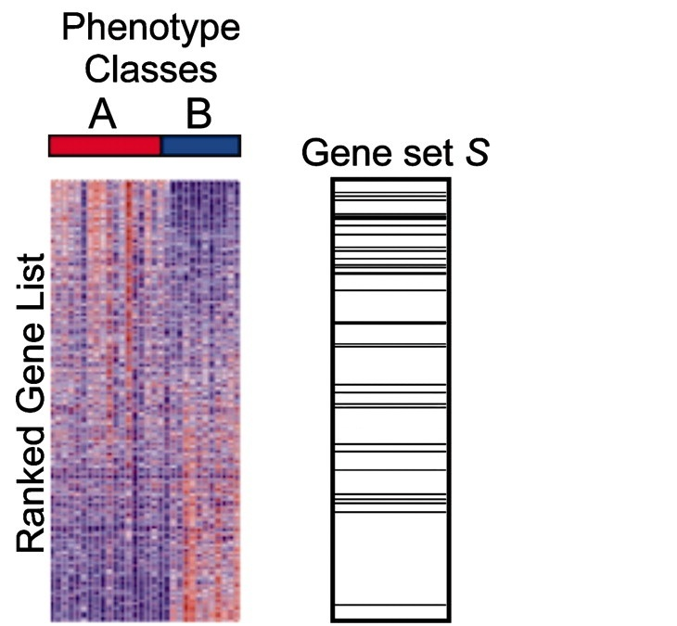
Kolmogorov–Smirnov (KS) Test
(upregulated)
Large, positive enrichment score
(downregulated)

Slide 38
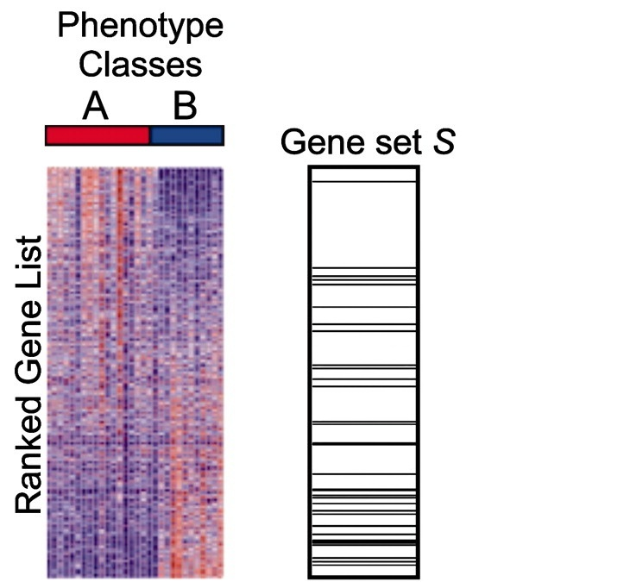
Kolmogorov–Smirnov (KS) Test
(upregulated)
Large, negative enrichment score
(downregulated)

Slide 39
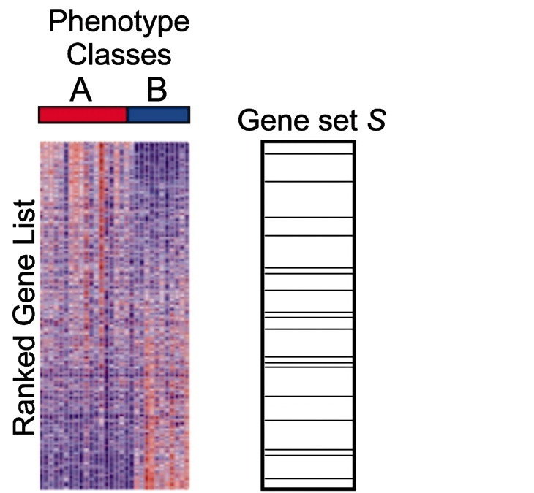
Kolmogorov–Smirnov (KS) Test
(upregulated)
Near zero enrichment score
(downregulated)

Slide 40
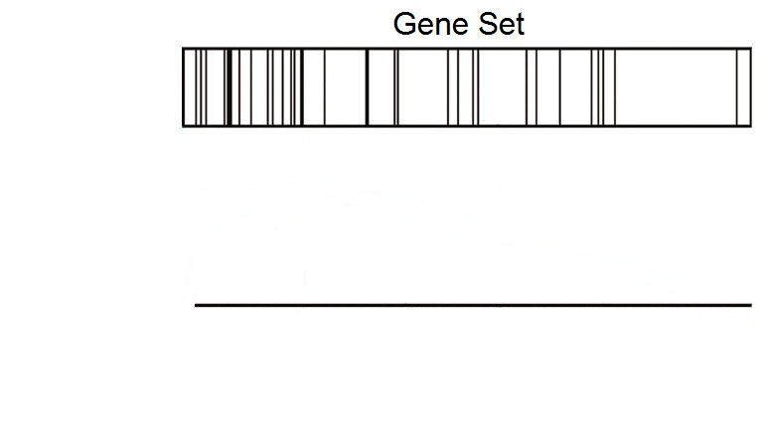
Kolmogorov–Smirnov (KS) Test
(upregulated)
(downregulated)

Slide 41
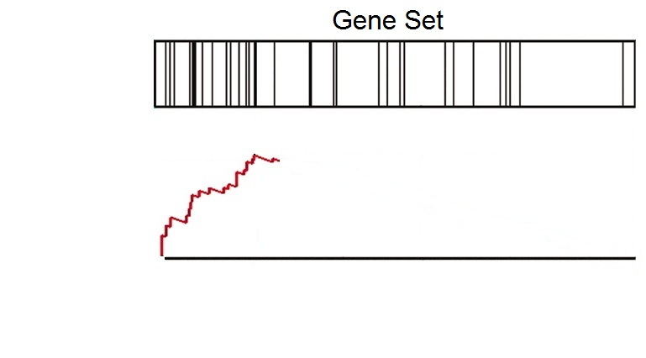
Kolmogorov–Smirnov (KS) Test
(upregulated)
(downregulated)

Slide 42
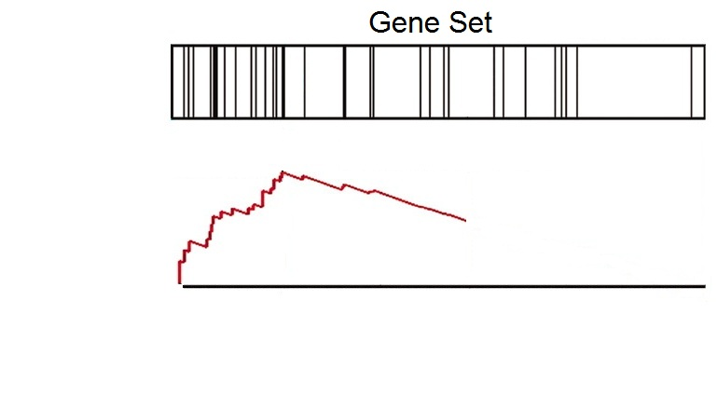
Kolmogorov–Smirnov (KS) Test
(upregulated)
(downregulated)

Slide 43
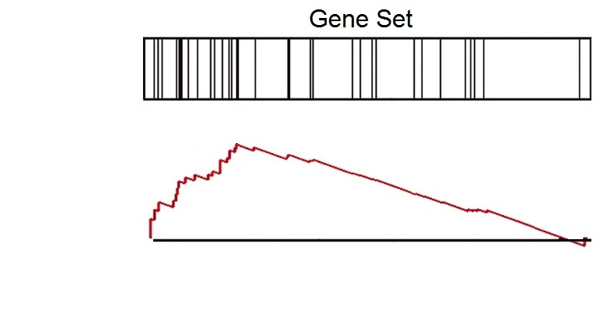
Kolmogorov–Smirnov (KS) Test
(upregulated)
(downregulated)

Slide 44
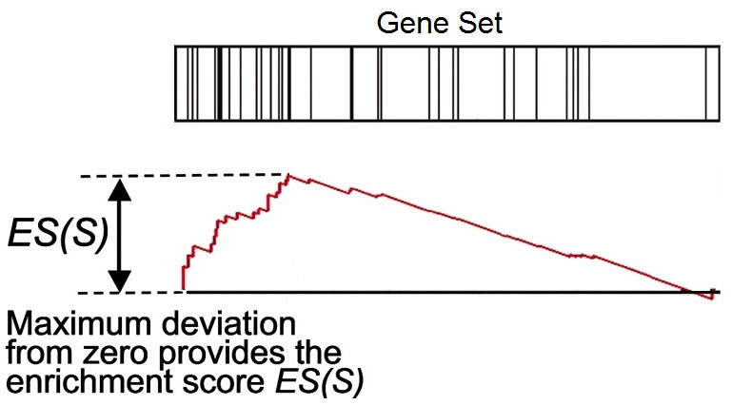
Kolmogorov–Smirnov (KS) Test
(upregulated)
(downregulated)

Slide 45
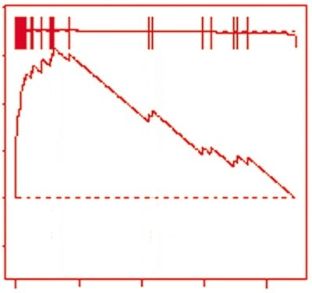
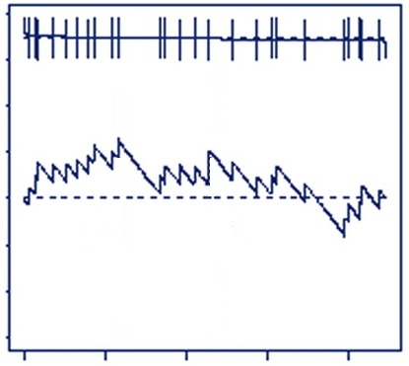
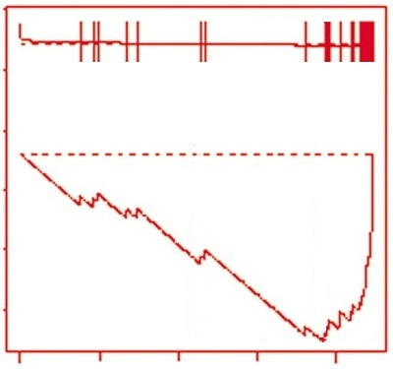
Kolmogorov–Smirnov (KS) Test
Many genes
upregulated
Genes
randomly distributed
Many genes
downregulated
Large positive
enrichment score
Near zero
enrichment score
Large negative
enrichment score

Slide 46
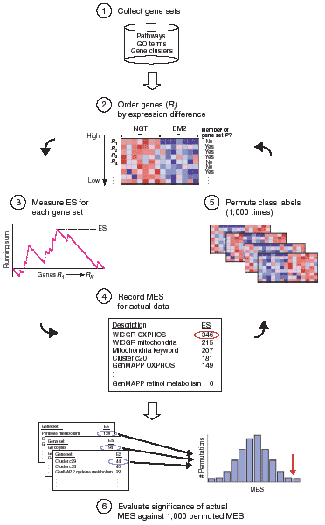
Mootha et al., Nature Genetics, 2003, 34(3):267-273

Slide 47
Kolmogorov–Smirnov (KS) Test
Used in Gene Set Enrichment Analysis (GSEA)
Free software (http://www.broadinstitute.org/gsea)
Pros:
Large collection of gene sets
Uses more information than methods that only use DEG list
Enrichment plot improves interpretability
Cons:
Permutation-based p-values

Slide 48
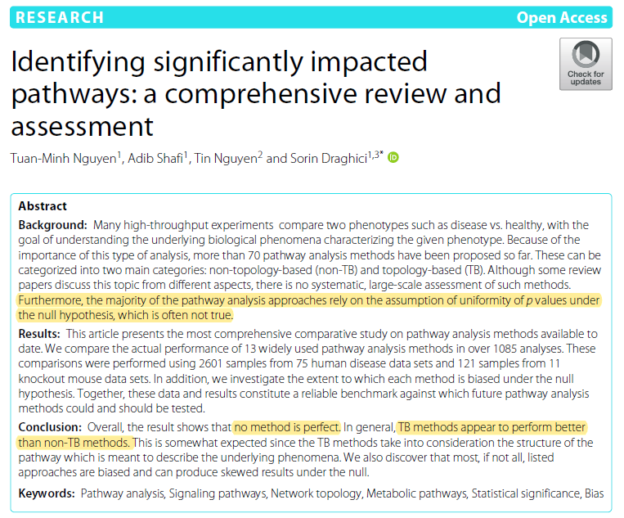

Slide 49
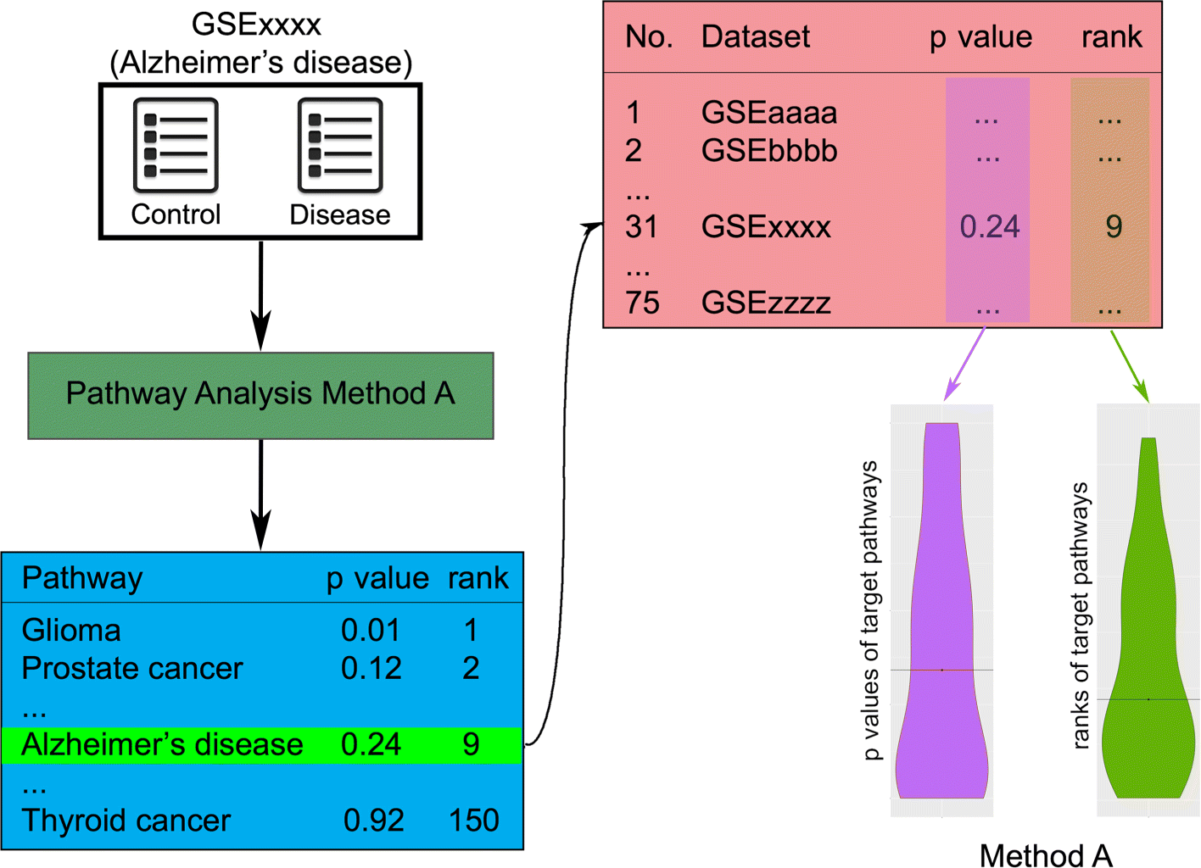
Notes:
The process of evaluating a pathway analysis method based on their ability to identify target pathways. Each pathway analysis method is applied on 75 data sets. Methods are evaluated based on their ability to rank the target pathways. In this example, a data set of Alzheimer’s disease is examined, and thus, the target pathway is “Alzheimer’s disease.” Each method produces lists of ranks and p values of the target pathways, which are then used to assess its performance

Slide 50
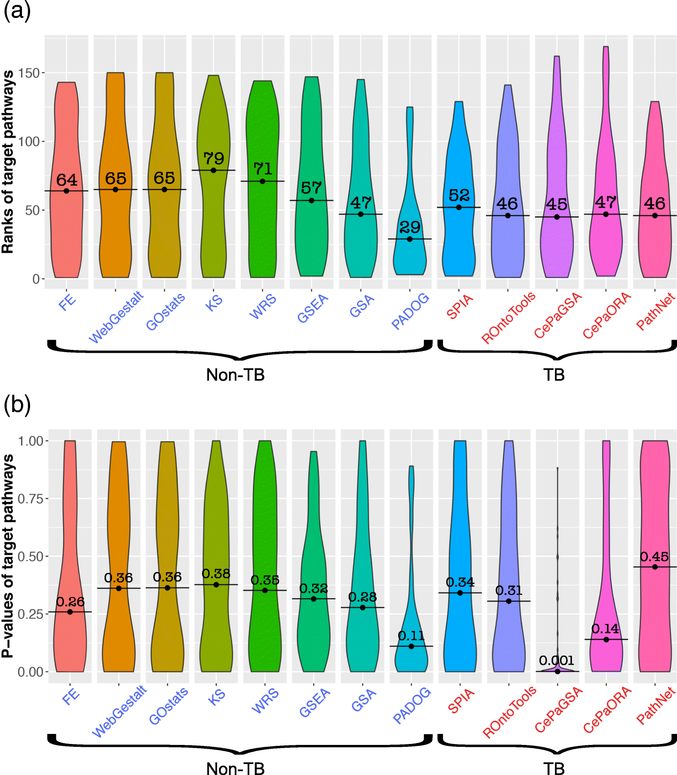
Notes:
The Ranks and p values of target pathways derived by 13 methods. We perform each method on 75 human benchmark data sets. The resulting ranks and p values of target pathways are plotted in violin plots. The horizontal axis shows the pathway analysis methods in both subfigures. The vertical axis in a represents the ranks while the vertical axis in b corresponds to p values of the target pathways. Hereafter, the labels of non-TB and TB methods are written in blue and red, respectively

Slide 51
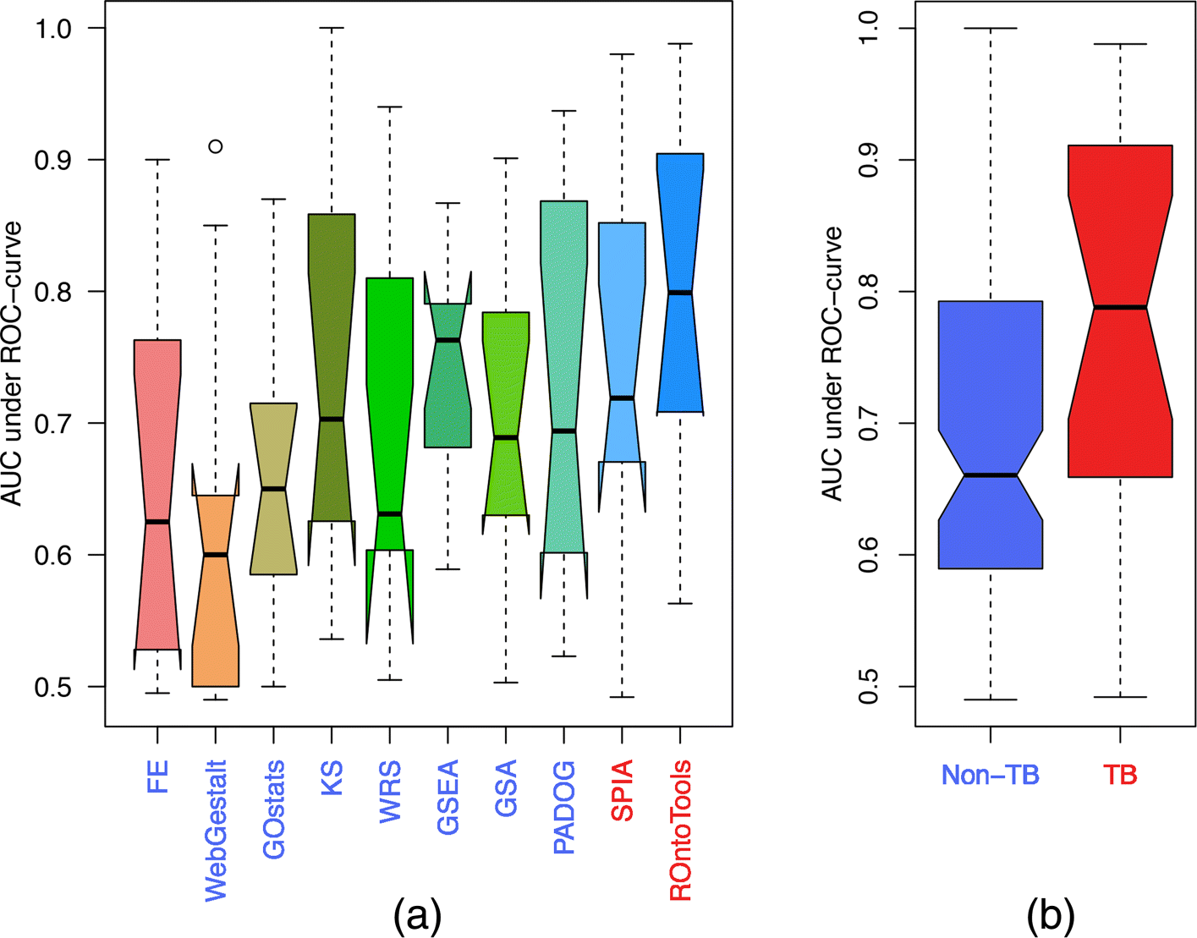
Notes:
The AUCs of eight methods using 11 KO data sets (higher is better). CePaORA, CePaGSA, and PathNet are left out in this comparison because they do not support mouse pathways. ROntoTools has the highest median value of AUC, followed by GSEA and SPIA (a). Overall, the AUCs obtained by TB methods are better than those from non-TB ones (Wilcoxon p value = 0.009) (b)

Slide 52
Temporary conclusions
No method is perfect
In general, TB methods appear to perform better than non-TB methods
Most, if not all, listed approaches are biased and can produce skewed results under the null
False positive
False negative

Slide 53
Now, it is your turn
Hands on practice on both parametric and non-parametric

Slide 54
Click to download

Slide 55
Provide your email

Slide 56

GSEA Example

Slide 57
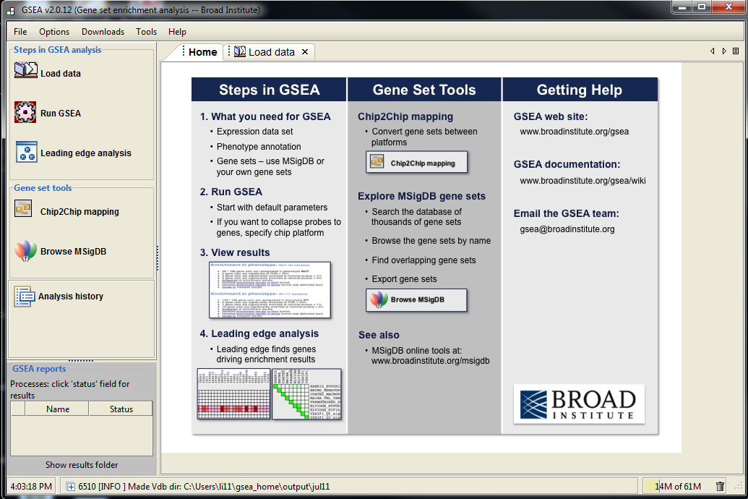
Step 1
Step 2
Step 3

Slide 58
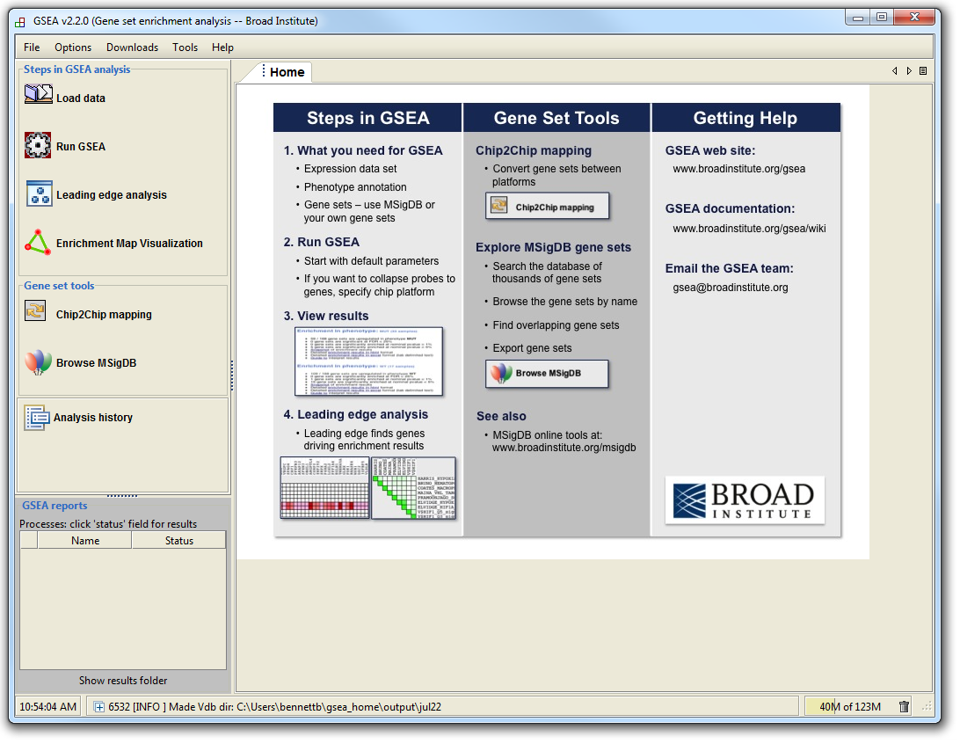
GSEA Example

Slide 59
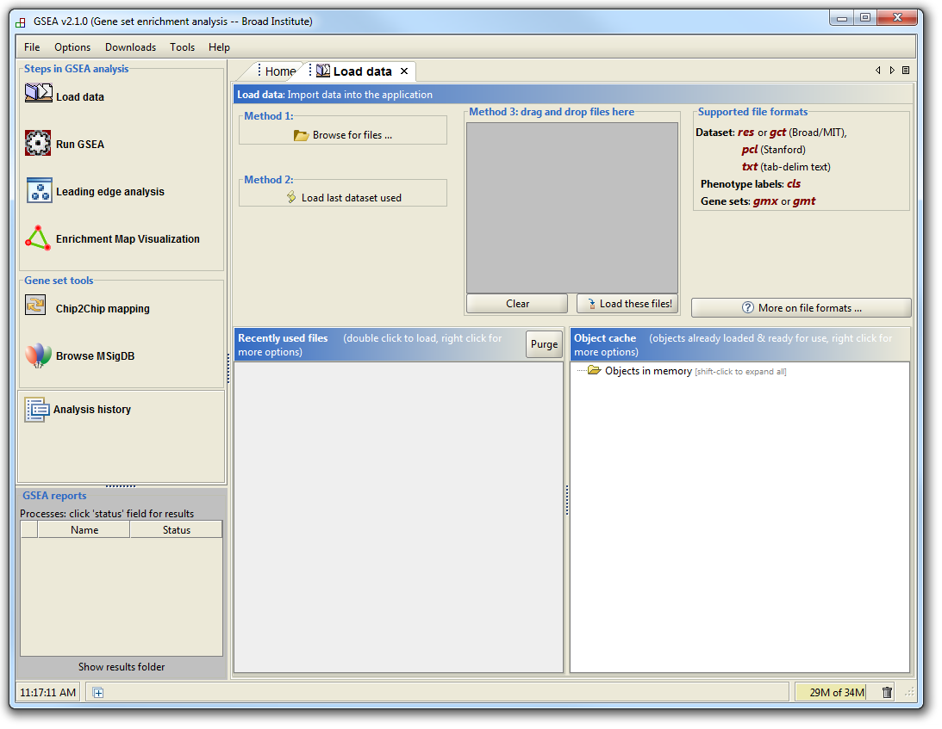
GSEA Example

Slide 60
GSEA Example
Supported file types:
http://www.broadinstitute.org/cancer/software/gsea/wiki/index.php/Data_formats
Required:
Expression data file
Class label file
Optional:
Gene set file

Slide 61
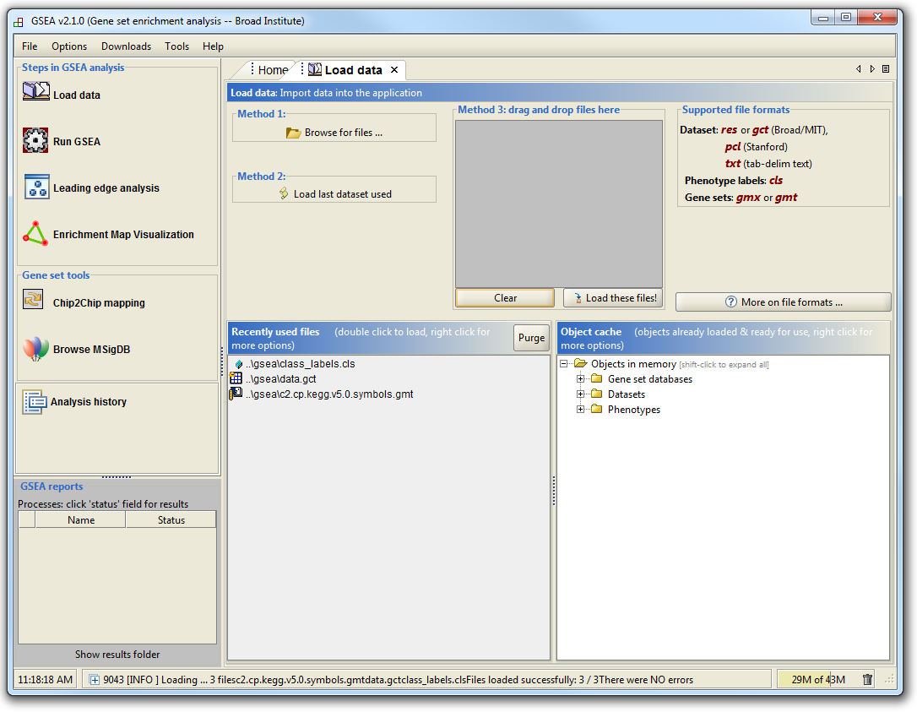
GSEA Example

Slide 62
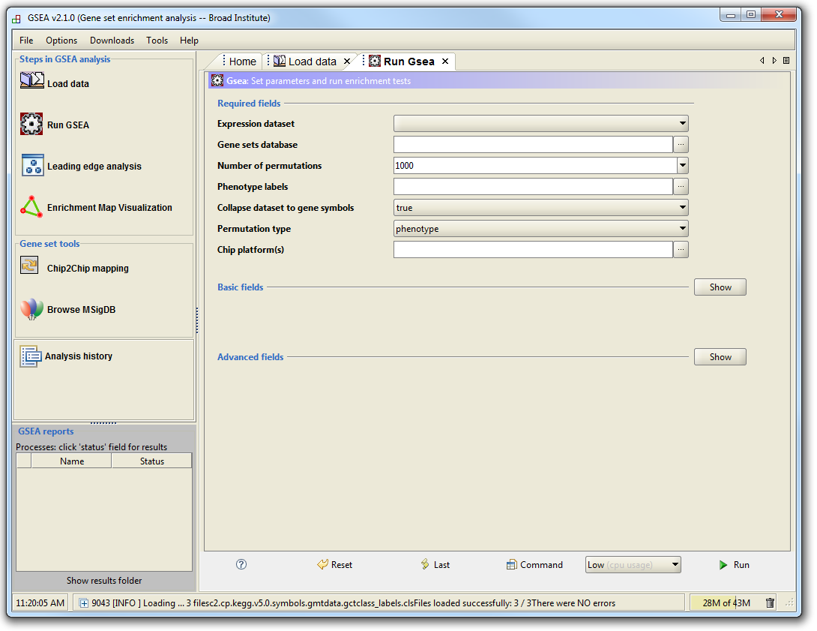
GSEA Example

Slide 63
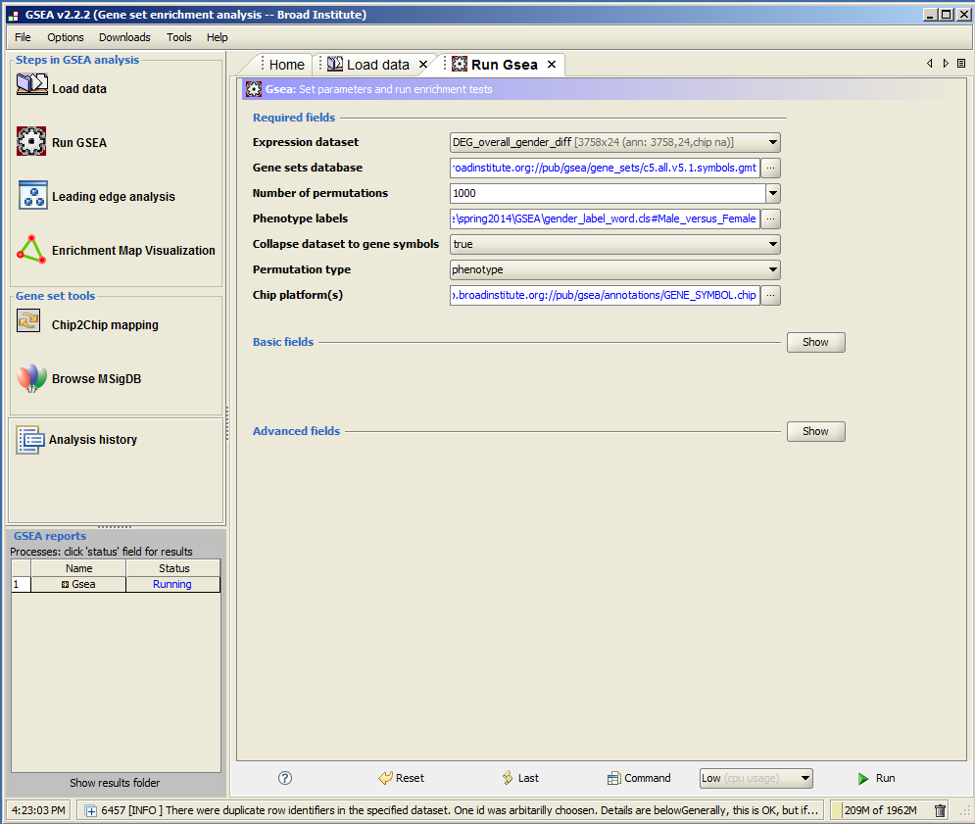

Slide 64
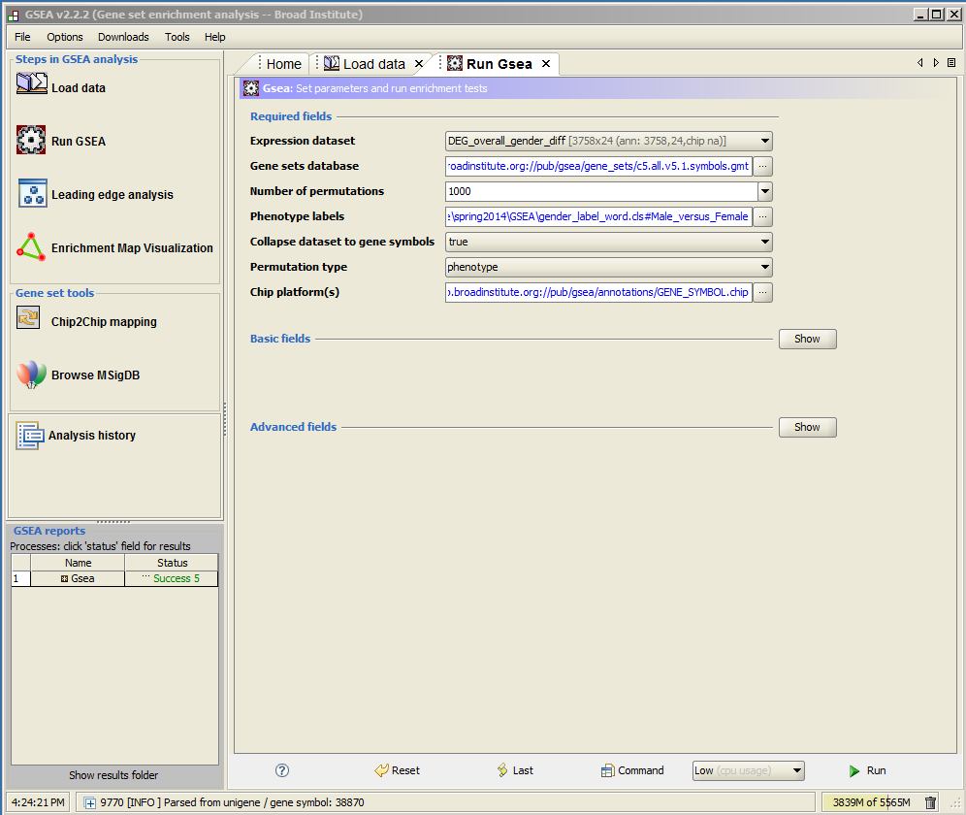
click

Slide 65
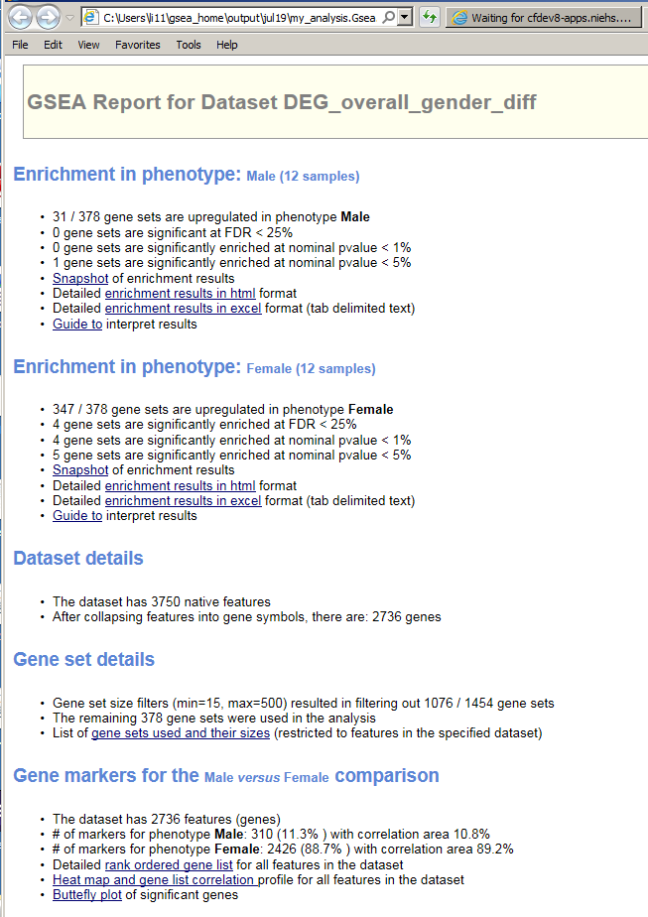

Slide 66
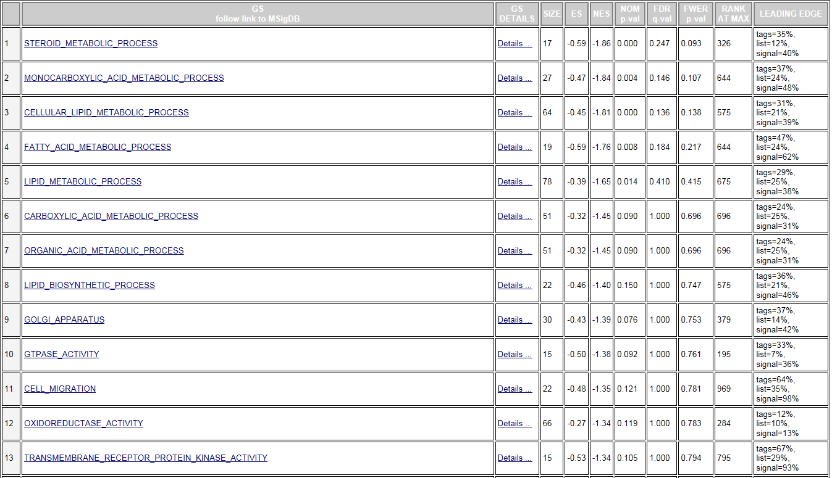

Slide 67
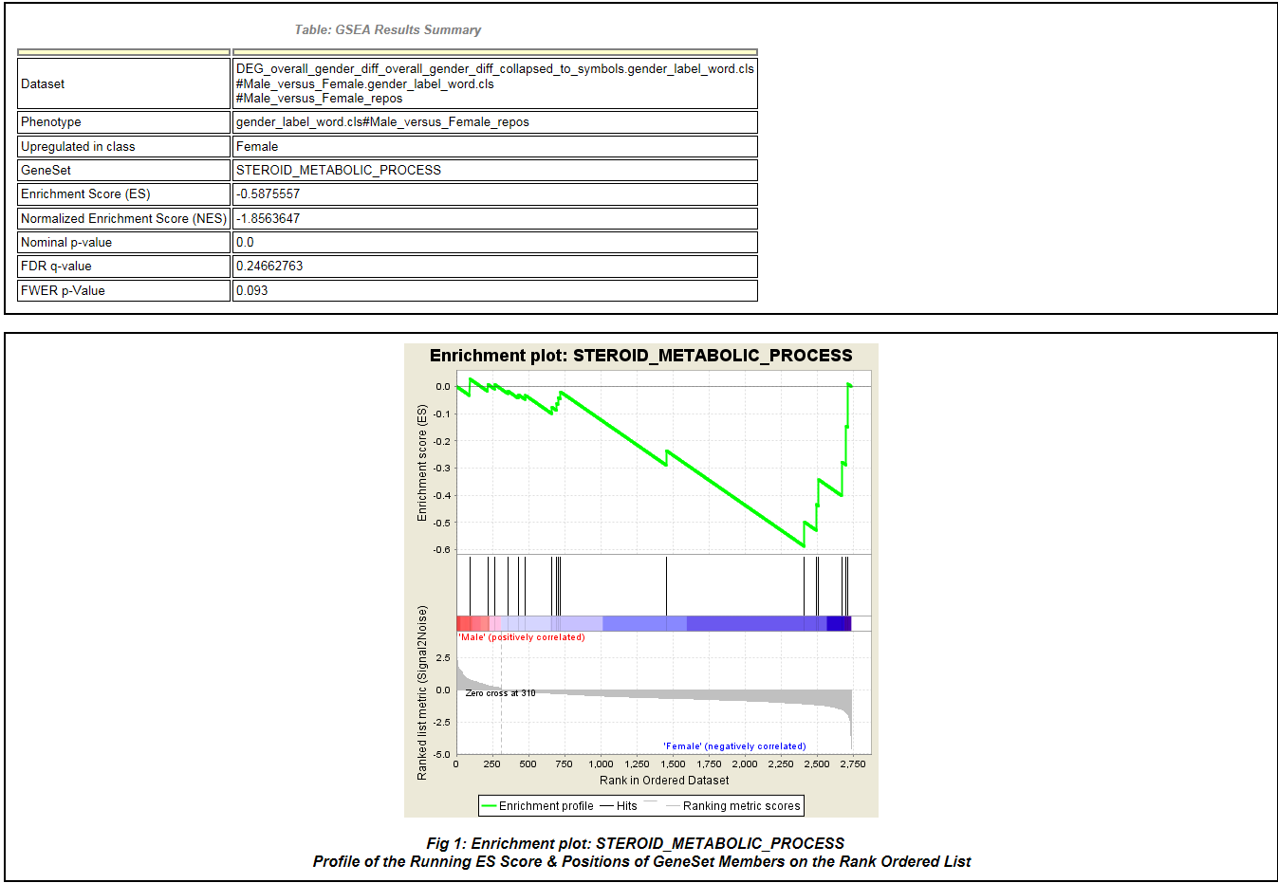
GSEA Example

Slide 68
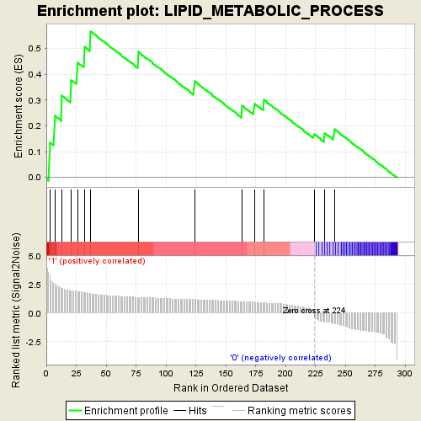
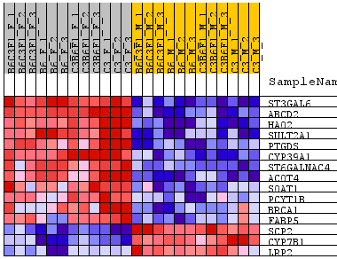
Lipid metabolism enriched -- GSEA

Slide 69
http://www-stat.stanford.edu/~tibs/GSA/
http://www.netsci.org/Resources/Software/Bioinform/pathwayanalysis.html
http://www.broadinstitute.org/gsea/index.jsp
http://david.abcc.ncifcrf.gov/
http://www.biocarta.com/
http://web.expasy.org/pathways/
http://www.genmapp.org/
http://www.genome.jp/kegg/
http://www.ingenuity.com/
http://www.genego.com/metacore.php
http://www.geneontology.org/
http://omicslab.genetics.ac.cn/GOEAST/tutorial.php
http://expressome.kobic.re.kr/GAzer/document.jsp
http://www.biobase-international.com/products
http://jaspar.genereg.net/

